Slide 1

FPGA Final Project
Team Members:
Habiba Hassan Suleiman
Mohamed Khalaf Mohamed
Saleh Mahmoud Saleh
Yara Hassan Shehata

Slide 2
Table of Contents
The Acceleration Concept 6. Software Development
2. AXI4 Lite Protocol 7. Simulation Results 3. IP Design 8. Comparison
4. System Design
5. Wrapping and Verification of the custom IP

Slide 3


The Acceleration Concept
Traditional Problem Solving Technique

Slide 4

The Acceleration Concept
Traditional Problem Solving Technique
Accelerator
Two-Way Communication

Slide 5

The Acceleration Concept
Traditional Problem Solving Technique
Accelerator
Two-Way Communication

Slide 6
The Acceleration Concept
Traditional Problem Solving Technique
Accelerator
Two-Way Communication

Slide 7
The Acceleration Concept
Traditional Problem Solving Technique
Accelerator
Two-Way Communication
Packet number 1

Slide 8
The Acceleration Concept
Traditional Problem Solving Technique
Accelerator
Two-Way Communication
Packet number 2

Slide 9
The Acceleration Concept
Traditional Problem Solving Technique
Accelerator
Two-Way Communication
Result

Slide 10
Standard Communication Protocol
AXI4 Lite Protocol
AXI4-Lite Master
AXI4-Lite Master
AXI4-Lite Master
AXI4-Lite Interconnect
AXI4-Lite Slave
AXI4-Lite Slave
AXI4-Lite Slave

Slide 11
Standard Communication Protocol
AXI4 Lite Protocol
AXI4-Lite Master
AXI4-Lite Master
AXI4-Lite Master
AXI4-Lite Master
AXI4-Lite Interconnect
Simple Interconnect
AXI4-Lite Slave
AXI4-Lite Slave
AXI4-Lite Slave
AXI4-Lite Slave

Slide 12
AXI4 Lite Protocol
AXI4-Lite Master
AXI4-Lite Master
AXI4-Lite Master
AXI4-Lite Master
AXI4-Lite Interconnect
Simple Interconnect
AXI4-Lite Slave
AXI4-Lite Slave
AXI4-Lite Slave
AXI4-Lite Slave

Slide 13
AXI4 Lite Protocol
AXI4-Lite Master
AXI4-Lite Slave
Write Address Channel
Write Data Channel
Write Response Channel
Read Address Channel
Read Data Channel

Slide 14
IP Design
Sign Calculator
Shifter
Exponent
Comparator
+ / -
Randomization & Normalization

Slide 15

System Design
32-bit AXI4-Lite Wrapper
Nios V/m processor
A[31:0]
32-bit Floating Point Adder (Custom IP)
Instruction Manager
Data Manager
32-bit AXI4-Lite Interface
B[31:0]
start
sum[31:0]
done
32-bit AXI4-Lite Interface
On Chip Memory
Instruction Memory
Data Memory

Slide 16
System Design
32-bit AXI4-Lite Wrapper
Nios V/m processor
A[31:0]
32-bit Floating Point Adder (Custom IP)
Instruction Manager
Data Manager
32-bit AXI4-Lite Interface
B[31:0]
start
sum[31:0]
done
32-bit AXI4-Lite Interface
On Chip Memory
Instruction Memory
Data Memory

Slide 17
System Design
Writing the first operand
32-bit AXI4-Lite Wrapper
Nios V/m processor
A[31:0]
32-bit Floating Point Adder (Custom IP)
Instruction Manager
Data Manager
B[31:0]
start
sum[31:0]
done
Instruction Memory
Data Memory

Slide 18
System Design
Writing the first operand
Fetching the Instruction
32-bit AXI4-Lite Wrapper
Nios V/m processor
Loading the base address and the offset to the processor
A[31:0]
32-bit Floating Point Adder (Custom IP)
Instruction Manager
Data Manager
B[31:0]
start
sum[31:0]
done
Instruction Memory
Data Memory

Slide 19
System Design
Writing the first operand
Loading the Data Word
32-bit AXI4-Lite Wrapper
Nios V/m processor
Loading the first operand to the processor
A[31:0]
32-bit Floating Point Adder (Custom IP)
Instruction Manager
Data Manager
B[31:0]
start
sum[31:0]
done
Instruction Memory
Data Memory

Slide 20
System Design
Writing the first operand
Send the write address to the custom IP
32-bit AXI4-Lite Wrapper
Nios V/m processor
Write Address Channel
Data Manager
A[31:0]
32-bit Floating Point Adder (Custom IP)
Instruction Manager
B[31:0]
start
Write Data Channel
sum[31:0]
done
Instruction Memory
Data Memory

Slide 21
System Design
Writing the first operand
Send the first operand to the custom IP
32-bit AXI4-Lite Wrapper
Nios V/m processor
Write Address Channel
Data Manager
A[31:0]
32-bit Floating Point Adder (Custom IP)
Instruction Manager
B[31:0]
start
Write Data Channel
sum[31:0]
done
Instruction Memory
Data Memory

Slide 22
System Design
Writing the second operand and the start signal
32-bit AXI4-Lite Wrapper
Nios V/m processor
Write Address Channel
Data Manager
A[31:0]
32-bit Floating Point Adder (Custom IP)
Instruction Manager
B[31:0]
start
Write Data Channel
sum[31:0]
done
Instruction Memory
Data Memory

Slide 23
System Design
Writing the second operand and the start signal
32-bit AXI4-Lite Wrapper
Nios V/m processor
Data Manager
A[31:0]
32-bit Floating Point Adder (Custom IP)
Instruction Manager
B[31:0]
start
sum[31:0]
done
Instruction Memory
Data Memory

Slide 24
System Design
The FP Adder Computes the result
32-bit AXI4-Lite Wrapper
Nios V/m processor
Data Manager
A[31:0]
32-bit Floating Point Adder (Custom IP)
Instruction Manager
B[31:0]
start
sum[31:0]
done
Instruction Memory
Data Memory

Slide 25
System Design
Receive the result from the custom IP
32-bit AXI4-Lite Wrapper
Nios V/m processor
Data Manager
A[31:0]
32-bit Floating Point Adder (Custom IP)
Instruction Manager
B[31:0]
start
rvalid
sum[31:0]
done
Instruction Memory
Data Memory

Slide 26
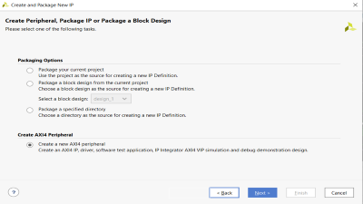
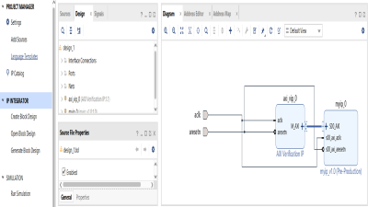
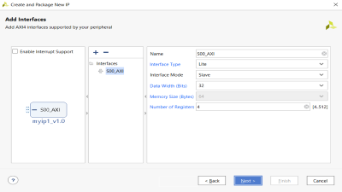
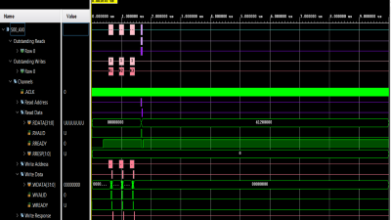
Wrapping and Verification of the Custom IP
Creating AXI4 Peripheral
32-bit AXI4-Lite Wrapper
Verifying the block
A[31:0]
32-bit Floating Point Adder (Custom IP)
B[31:0]
start
sum[31:0]
Customizing the AXI4 Peripheral
done
Creating Block Design

Slide 27
Software Development
DATA OF REGISTER A
#include "io.h“
#define FPAdder_slv_regs_BaseAddress 0x00050000
int main()
{
unsigned int A, B, start, ans;
A = 0x40400000; B = 0x40E00000; start = 0x00000001;
IOWR(FPAdder_slv_regs_BaseAddress, 0x0, A);
IOWR(FPAdder_slv_regs_BaseAddress, 0x1, B);
IOWR(FPAdder_slv_regs_BaseAddress, 0x2, start);
ans = IORD (FPAdder_slv_regs_BaseAddress, 0);
while (1);
return 0;}
0
x
4
0
4
DATA OF REGISTER B
0
x
4
0
E
Signed Scalar Slicing . Mohamed Khalaf
27

Slide 28
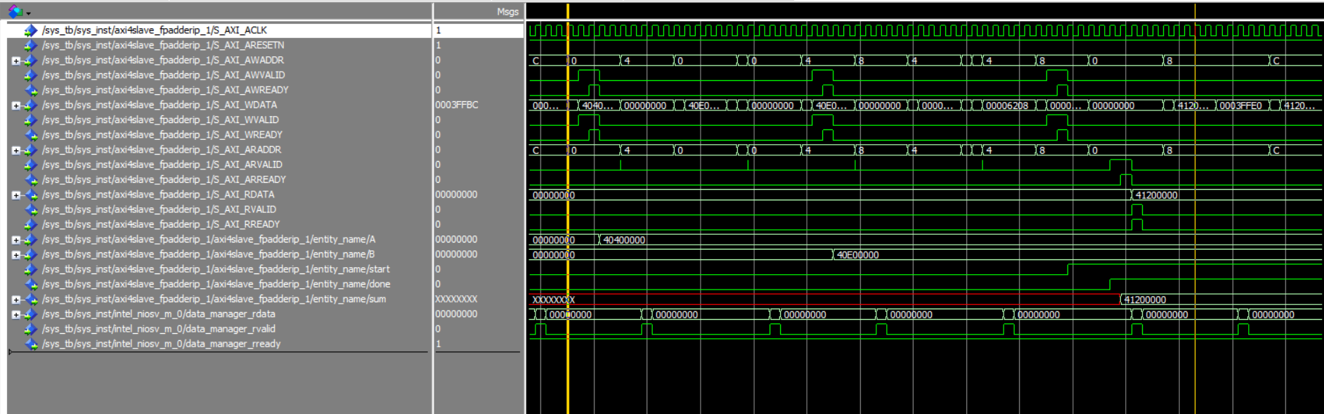
Simulation Results
Custom IP Side

Slide 29
Simulation Results
Custom IP Side
Write Transactions
A = 3.0
A = 7.0
Start

Slide 30
Simulation Results
Custom IP Side
Read Transaction
A = 10.0

Slide 31
Simulation Results
Processor Side
Read Transaction
A = 10.0

Slide 32
Comparison
CPU vs. Accelerator
 | CPU | Using Hardware Acceleration
 |  | With Communication overhead | Without communication overhead
Number of clock cycles for 1.7 GHZ | 1341300 | 56 | 5

Slide 33
Thank You

Slide 34
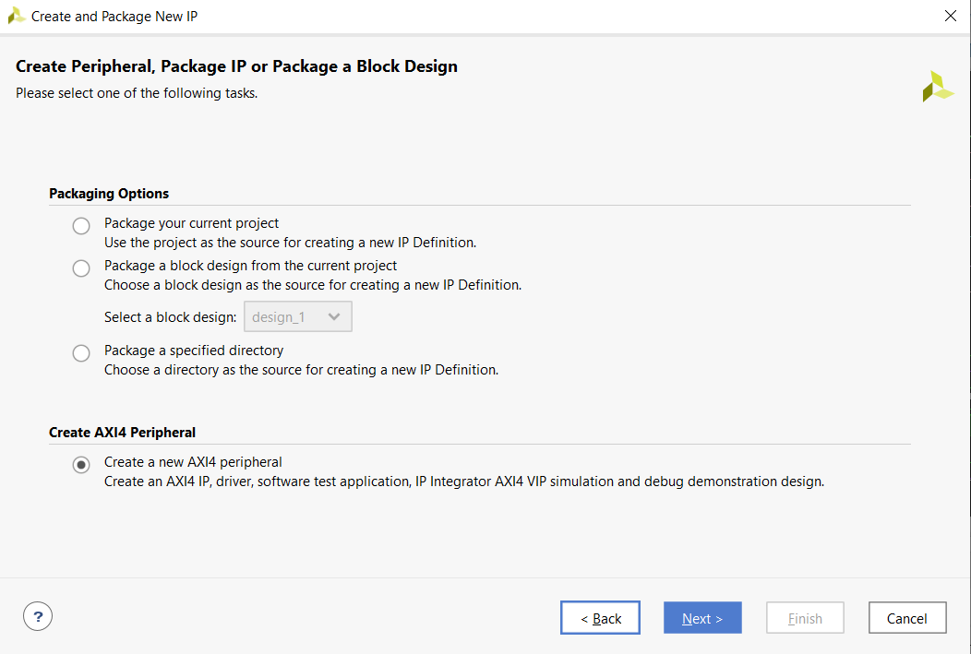

Slide 35


Slide 36
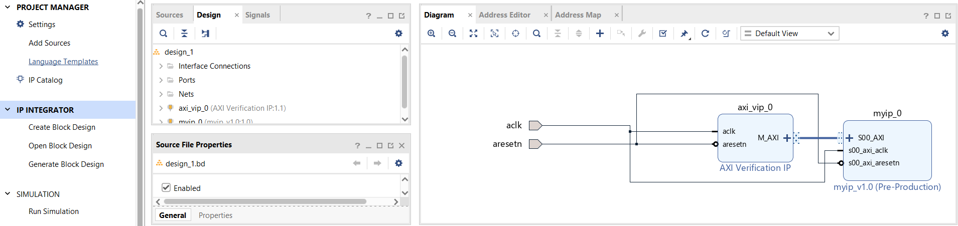

Slide 37


